Slide 1
Unique Skill Sets for Aviation Industry
Student’s Name
Institutional Affiliations
Date

Slide 2
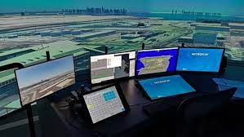
Air Traffic Controller
Organize the movement of planes to uphold benign distances between them
Provides landing and takeoff directions to pilots
Communicate with pilots concerning weather and other perilous information (BLS, 2021)
Allows change in control of leaving planes to other traffic control centers
Inform airfield reply specialist in the occurrence of any danger
Notes:
The air traffic controller is one of the critical elements in the aviation industry. Therefore, the air traffic controller is responsible for organizing planes' movement and preserving safe distances between the aircraft. Similarly, since they are in the control center, they must direct the landing and takeoff directions to the pilot to ensure a safe flight. Pilots always need communication from the control center, and thus they get hazardous information such as dangerous weather from the air traffic controller (BLS, 2021). Air traffic controllers are also vital in enabling the transfer of planes that have departed to the required control centers and accept those arriving. Finally, notify the airport response team concerning any emerging events or activities requiring their presence.

Slide 3
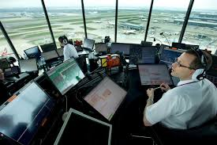
Unique Personal Skills
Effective communication (Knecht et al., 2016)
Ability to solve problems
Decision-making skills
Concentrate for long hours
Organization skills
Notes:
Air traffic controllers need to have the capacity to listen communicate clearly because they will be involved in giving instructions to pilots (Knecht et al., 2016). Therefore, they need to offer vibrant and concise guidelines and listen to the request given effectively. Problems might occur anytime, such as weather changes, and controllers will need to evaluate the information and offer suitable solutions to the pilots. Controllers must have the capacity to make decisions faster and react to the changes as requested to ensure the plane's safety. The control room has several controllers, each talking to the pilot; thus, controllers need to have good concentration, work in such a situation and concentrate for long hours. Lastly are the organization skills because they might be required to handle several flights, prioritizing responsibilities and ensuring all pilots are served.

Slide 4
Unique Professional Skills
Virtuous spatial awareness and robust mathematical skills (Soldatov et al., 2018)
Associates or bachelor's degree from AT-CTI package (BLS, 2021)
Others can attend three years of gradually growing work practice
Some of the topics offered are aviation airspace, reading charts and regulations
Notes:
Before one can become an air traffic controller, one must meet the professional skills needed. Academic skills are vital, and one of them is moral spatial consciousness and solid mathematical skills because they will need to do calculations such as speed and distances as fast as possible and provide altitude variations (Soldatov et al., 2018). The controller needs an associate's or a bachelor's degree from an AT-CTI package (BLS, 2021). Nevertheless, other applicants will need to obtain three years of gradual work experience or finish four years in college. The federal aviation administration offers the instructions to the program. They can teach the controllers topics related to aviation, such as aviation reading charts and airspace.

Slide 5
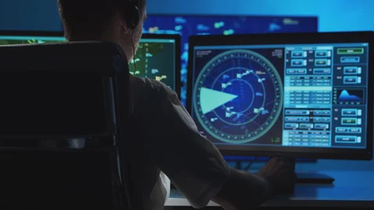
Necessary Qualifications
Pass the medical assessment
Finish a exercise development at the FAA education
Be an American resident
Pass Air Traffic Controller Specialist Skills Assessment Battery (ATSA) (BLS, 2021)
Notes:
One of the essential air traffic controller requirements is to pass the medical assessment, which comprises drug screening and other background evaluations. Also, medical assessment for controllers is physical and mental health checks. FAA education is vital to provide them with aviation skills, and the required candidates must begin it before thirty-one years. In the United States, one must be an American citizen to work as a controller. Similarly, the candidate must pass the ATSA evaluation, which takes one hundred and seventy minutes to finish (BLS, 2021). ATSA skills evaluation comprises several subtests developed to measure various skills and abilities required to be an effective controller.

Slide 6
Benefits of personal and professional skills to employers
Ensure the aircraft land and depart safely
Safeguard the regulations by keeping them up to date
Efficiently manage the operations of the aviation industry and use of new technologies
Involve in ensuring the risk management
Modify policies and processes for benign and effective operations, guidelines, and training approaches (Knecht et al., 2016)
Notes:
The controller's unique personal and professional skills set are vital in the aviation industry. At the same time, the industry is working to ensure safety and reliable communication between the pilot and the control center. Aircraft can quickly move to their destination through efficient communication; therefore, controllers are critical in ensuring the landing and departure of the planes. The skills benefit the aviation industry by safeguarding the regulations and keeping them up to date because new systems and technologies emerge and require proper skills. Also, the skills help the industry to manage the aircraft operations by involving and ensuring risks are managed. The skills ensure that the aviation industry changes policies and processes to guarantee safety and efficient operations (Knecht et al., 2016).

Slide 7
References
BLS (2021). Air Traffic Controllers. U.S Bureau of Labor Statistics. https://www.bls.gov/ooh/transportation-and-material-moving/air-traffic-controllers.htm#tab-2
Knecht, C. P., Muehlethaler, C. M., & Elfering, A. (2016). Nontechnical skills training in air traffic management including computer-based simulation methods: From scientific analyses to prototype training. Aviation psychology and applied human factors, 6(2), 91.
Soldatov, S. K., Zasyad’ko, K. I., Bogomolov, A. V., Vonarshenko, A. P., & Solomka, A. V. (2018). Professionally Important Skills of Air Traffic Controllers. Human Physiology, 44(7), 775-778.

